Slide 1
Adversarial Training Methods for Semi-Supervised Text Classification
ICLR 2017 Takeru Miyato,Andrew M Dai,Ian Goodfellow
周杰
2017/06/8

Slide 2
Motivation
Adversarial training和virtual adversarial training都需要对输入的数字形式做小的perturbation，不适用于高维稀疏输入，比如one-hot word representations。
文章扩展图像领域流行的这两种方法到文本领域，对word embedding进行perturbation来作为LSTM的输入，取代原本的输入向量。
把这两种方法看做是正则化的方法，为输入加入噪声，可以用来实现semi-supervised的任务。

Slide 3
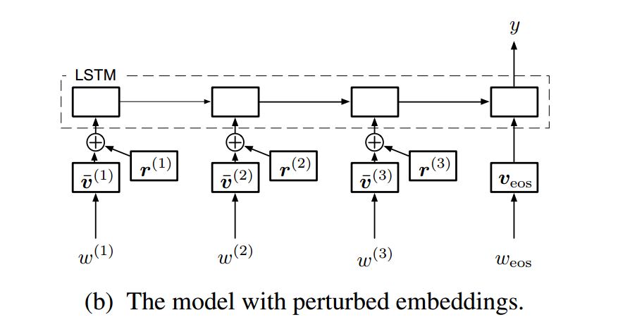
Motivation

Slide 4


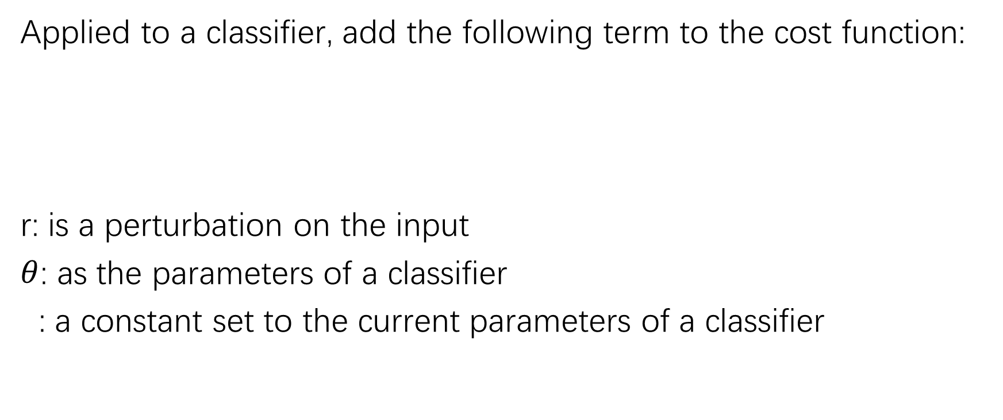
Adversarial Training
Applied to a classifier, add the following term to the cost function:
r: is a perturbation on the input
$θ$: as the parameters of a classifier
: a constant set to the current parameters of a classifier

Slide 5

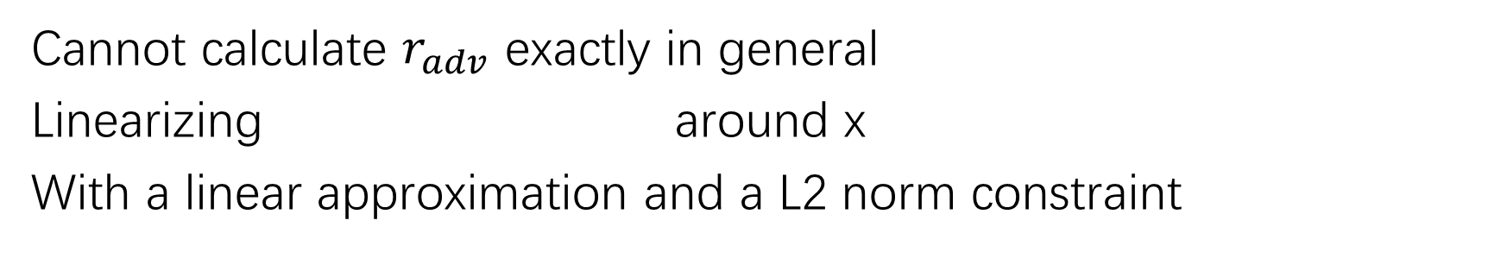
Adversarial Training
Cannot calculate $r_{adv}$ exactly in general
Linearizing around x
With a linear approximation and a L2 norm constraint

Slide 6
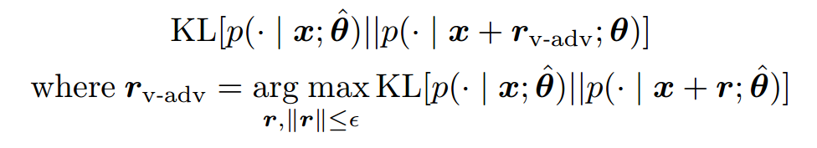
Virtual Adversarial Training
Applied to a classifier, add the following term to the cost function:
r: is a perturbation on the input
$θ$: as the parameters of a classifier
: a constant set to the current parameters of a classifier

Slide 7
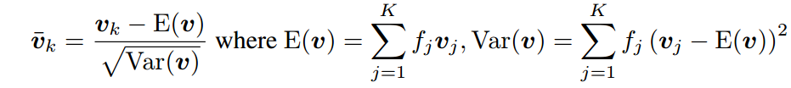
Processing
Normalized embeddings

Slide 8
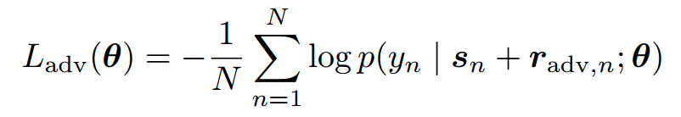
Adversarial Loss

Slide 9
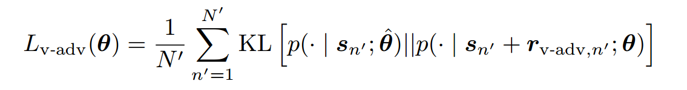
Virtual Adversarial Loss

Slide 10
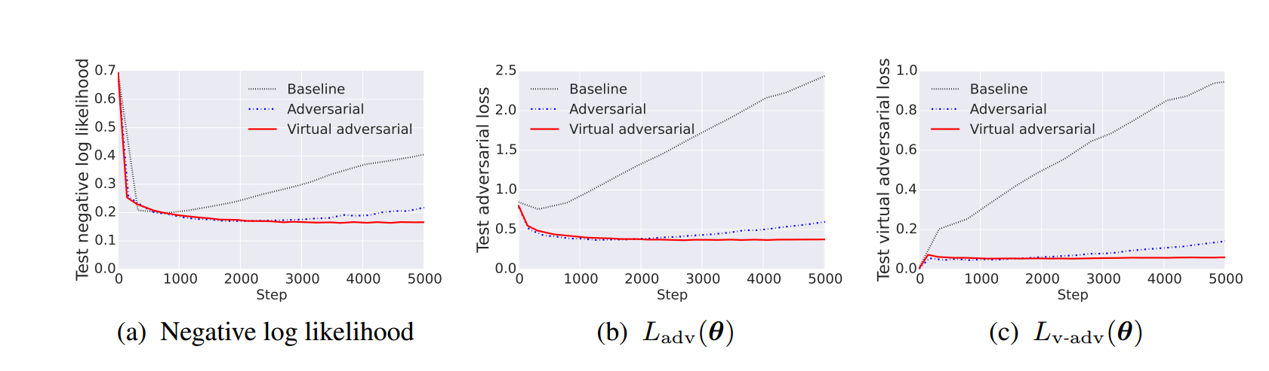
Results

Slide 11
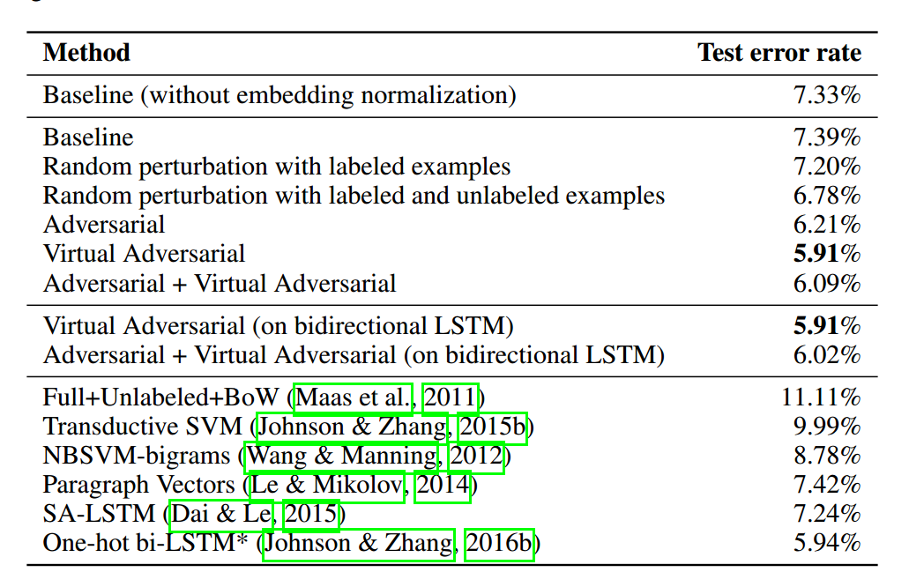
Results

Slide 12
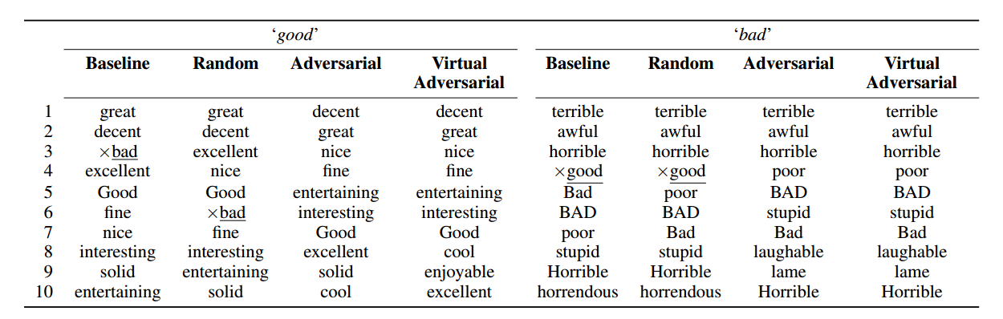
Results

Slide 13
Thanks!

